Slide 1
Module – 4 Intelligent storage system
Module 4: Intelligent Storage System
1
Notes:
Module – 4
Intelligent Storage System

Slide 2
Module 4: Intelligent Storage System
Upon completion of this module, you should be able to:
Describe the key components of intelligent storage system
Describe cache management and protection techniques
Describe two storage provisioning methods
Describe two types of intelligent storage systems

Slide 3
Module 4: Intelligent Storage System
Lesson 1: Key Components of an Intelligent Storage System
During this lesson the following topics are covered:
Intelligent storage system overview
Key components of an intelligent storage system
Cache management

Slide 4
What is an Intelligent Storage System (ISS) ?
Intelligent Storage System
It is a feature-rich RAID array that provides highly optimized I/O processing capabilities.
Provides large amount of cache and multiple I/O paths that enhances the performance
Has an operating environment that provides
Intelligent cache management
Array resource management
Connectivity to heterogeneous hosts
Supports flash drive, virtual provisioning, and automated storage tiering

Slide 5



Key Components of an ISS
Intelligent Storage System
Host
Front End
Back End
Physical Disks
Cache
Connectivity
Storage
Network

Slide 6
Key Components of ISS: Front End
Intelligent Storage System
Host
Front End
Back End
Physical Disks
Cache
Storage
Network
Ports
Controllers

Slide 7
Key Components of ISS: Cache
Intelligent Storage System
Host
Front End
Back End
Physical Disks
Cache
Storage
Network

Slide 8
Read Operation with Cache
Data found in cache = Read hit
Data found in cache
1. Read Request
2. Data sent to host
Data not found in cache = Read miss
Data not found in cache
1. Read Request
2. Read Request
4. Data sent to host
3. Data copied to cache

Slide 9
Write Operation with Cache
Write-through cache
Cache
1. Data write
2. Data write
4. Acknowledgment
3. Acknowledgment
Write-back cache
Cache
1. Data write
3. Data write
2. Acknowledgment
4. Acknowledgment

Slide 10
Cache Management: Algorithms
Least recently used (LRU)
Discards data that have not been accessed for a long time
Most recently used (MRU)
Discards data that have been most recently accessed
New Data
Cache
LRU/MRU Data

Slide 11
Cache Management: Watermarking
Manages I/O burst through flushing process
Flushing is the process of committing data from cache to the disk
Three modes of flushing to manage cache utilization are:
Idle flushing
High watermark flushing
Forced flushing
100%
HWM
LWM
Idle flushing
High watermark flushing
Forced flushing

Slide 12
Cache Data Protection
Protects data in the cache against power or cache failures:
Cache mirroring
Provides protection to data against cache failure
Each write to the cache is held in two different memory locations on two independent memory cards
Cache vaulting
Provides protection to data against power failure
In the event of power failure, uncommitted data is dumped to a dedicated set of drives called vault drives

Slide 13
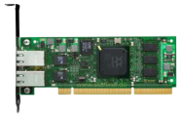

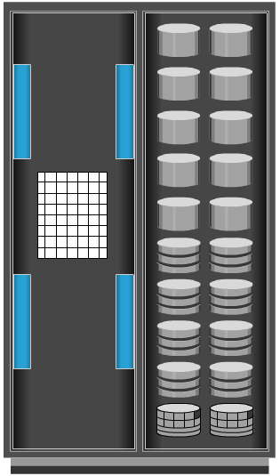
Server Flash-caching Technology
Host
Uses intelligent caching software and PCIe flash card on host
Dramatically improves application performance
Provides performance acceleration for read-intensive workloads
Avoids network latencies associated with I/O access to the storage array
Intelligently determines data that would benefit by sitting in server on PCIe flash
Uses minimal CPU and memory resources
Flash management is offloaded onto PCIe card
Application
Intelligent Caching Software
HBA
PCIe Flash Card
Storage
Network
Storage Array

Slide 14
Key Components of ISS: Back End
Intelligent Storage System
Host
Front End
Back End
Physical Disks
Cache
Storage
Network
Controllers
Ports

Slide 15
Key Components of ISS: Physical Disks
Intelligent Storage System
Host
Front End
Back End
Physical Disks
Cache
Storage
Network

Slide 16
Module 4: Intelligent Storage System
Lesson 2: Storage provisioning and ISS implementation
During this lesson the following topics are covered:
Traditional storage provisioning
Virtual storage provisioning
ISS implementation

Slide 17
Assigning Storage to Host
Storage Provisioning
It is the process of assigning storage resources to hosts based on capacity, availability, and performance requirements of applications running on the hosts.
Can be performed in two ways:
Traditional storage provisioning
Virtual storage provisioning

Slide 18
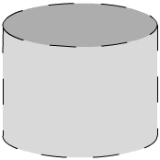
Traditional Storage Provisioning
Host 1
Intelligent Storage System
Physical Disks
(RAID Set)
LUN 0
Front End
Back End
Cache
LUN 0
Storage
Network
LUN 1
LUN 1
Host 2

Slide 19
LUN Expansion
Base LUN
Component LUN
MetaLUN
+
It is a method to expand LUNs that require additional capacity or performance.
Created by combining two or more LUNs
MetaLUNs can either be concatenated or striped
Concatenated metaLUN
Provides only additional capacity but no performance
Expansion is quick as data is not restriped
Striped metaLUN
Provides capacity and performance
Expansion is slow as data is restriped
Concatenated MetaLUN
Base LUN
Component LUN
+
Striped MetaLUN

Slide 20

Virtual Storage Provisioning
Host 1
10 TB
Thin LUN 0
Host
Reported Capacity
Intelligent Storage System
3 TB
Allocated
Physical Disks
(Shared Pool)
Front End
Back End
Cache
Thin LUN 0
Storage
Network
Thin LUN 1
10 TB
Thin LUN 1
Host
Reported Capacity
Host 2
4 TB
Allocated

Slide 21

Traditional Provisioning vs. Virtual Provisioning
150 GB Available
Capacity
1500 GB
or
1.5 TB
Allocated
Unused
Capacity
1650 GB
or
1.65 TB
Available
Capacity
800 GB
800 GB
550 GB
550 GB
500 GB
500 GB
600 GB
Allocated
Unused
Capacity
400 GB
Allocated
Unused
Capacity
500 GB
Allocated
Unused
Capacity
350 GB
Actual data
350 GB
Actual data
100 GB Data
200 GB Data
100 GB Allocated
50 GB Allocated
200 GB Allocated
50 GB Data
LUN 1
LUN 2
LUN 3
Storage System 2 TB
Thin LUN 1
Thin LUN 2
Thin LUN 3
Storage System 2 TB
Traditional Provisioning
Virtual Provisioning

Slide 22
LUN Masking
LUN Masking
It is a process that provides data access control by defining which LUNs a host can access.
Implemented on storage array
Prevents unauthorized or accidental use of LUNs in a shared environment

Slide 23
Types of ISS: High-end Storage Systems
Referred as active-active arrays, and generally aimed at large enterprise applications
Performs I/Os to LUNs through all the available paths
These arrays provide the following capabilities:
Large storage capacity and cache
Fault tolerant architecture
Connectivity to mainframe and open systems
Multiple front-end ports and interface protocols
Ability to handle large amount of concurrent I/Os
Support local and remote data replication
Controller
A
Port
Active
LUN
Controller
B
Active
Port
Host
Storage Array
Active-Active Configuration

Slide 24
Types of ISS: Midrange Storage Systems
Referred as active-passive arrays, and generally aimed at small and medium-sized enterprise applications
Performs I/Os to LUNs only through active paths
These arrays typically have two controllers, each with cache, RAID controllers, and disks drive interfaces
Less front-end ports, storage capacity, and cache as compared to high-end arrays
Support local and remote data replication
Controller
A
Port
Active
LUN
Controller
B
Passive
Port
Host
Storage Array
Active-Passive Configuration

Slide 25
Module 4: Intelligent Storage System
Concept in Practice
EMC VNX
EMC Symmetrix VMAX

Slide 26
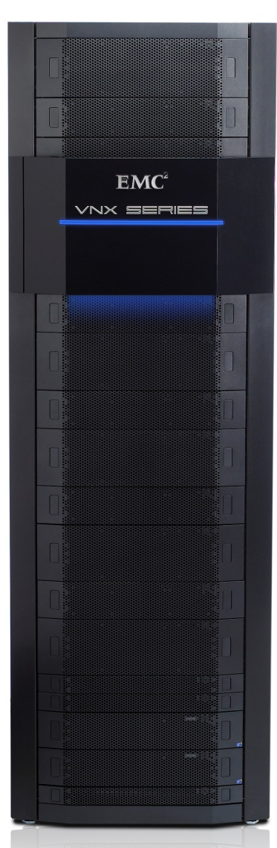
EMC VNX
EMC’s midrange storage offering
Unified storage offering that provides storage for block, file, and object data
Ideally suited for applications with predictable workloads
EMC VNX

Slide 27
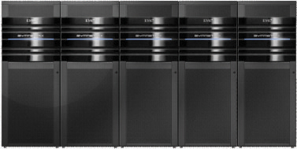
EMC Symmetrix VMAX
EMC’s high-end storage offering
Key features supported by Symmetrix VMAX are:
Incrementally scalable to 2,400 disks
Supports up to 8 VMAX engines
Supports flash drives, fully automated storage tiering (FAST), virtual provisioning, and cloud computing
Supports up to 1 TB of global cache memory
Supports FC, iSCSI, GigE, and FICON for host connectivity
Supports RAID levels 1, 1+0, 5, and 6
Supports storage-based replication via EMC TimeFinder and SRDF
EMC Symmetrix VMAX

Slide 28
Module 4: Summary
Key points covered in this module:
Key components of intelligent storage system
Cache management and protection techniques
Storage provisioning methods
Types of intelligent storage systems

